Slide 1
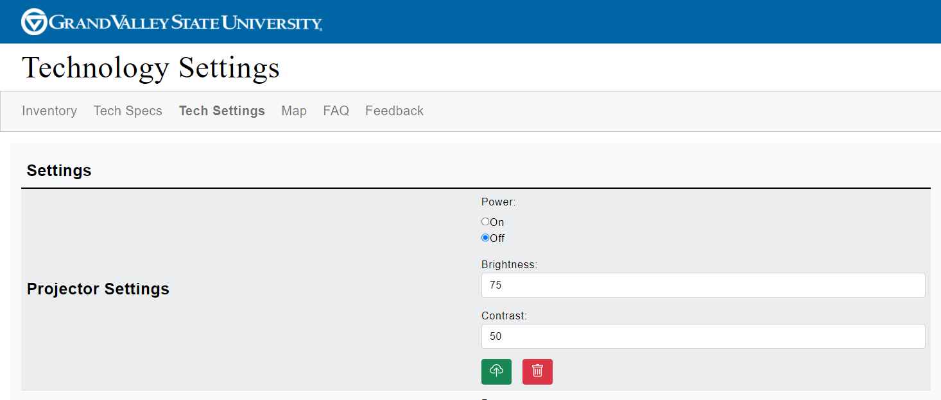
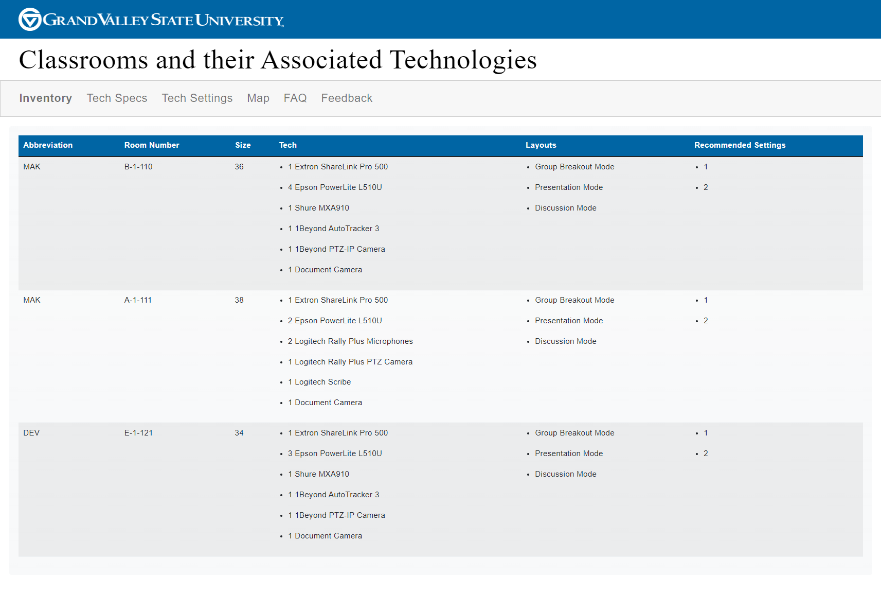
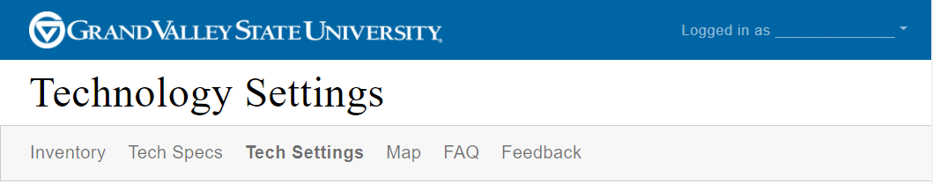
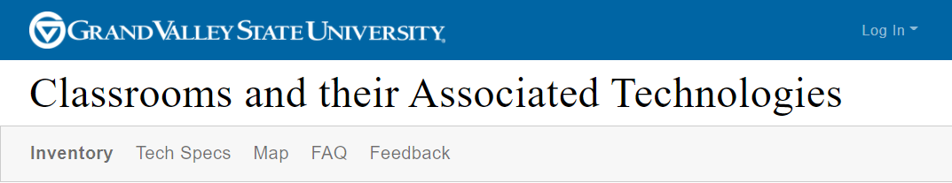
Smart Start: Web-Based Classroom Inventory and
Personalized Smart Classroom Settings
Noah Mutersbaugh, David Powers, and Mohammad Saleh Eric Kunnen (GVSU)
Overview
The Smart Start project includes a database of smart classroom technology and allows users to have personalized settings that are automatically applied upon entry to the classroom.
Personal Preferences and Technology Settings
MongoDB
MongoDB is a free database hosting site that provides the capability of storing the users’ personal preferences and can easily be transferred to another database solution in the future.
Technology Settings
In order to lay the foundation for future implementation, the technology settings are easily accessible from the database using a packages called ExpressJS, Axios, and MongoDB NodeJS Driver. These personalized settings are only available to users that have been authenticated by Google OAuth 2.0 and have been given specific permission by administrators. In other words, not every user will be able to see or change their technology settings, even though they have access to the inventory database and the rest of the application.
Classroom Inventory Database
This allows the administrators of the project to keep track of technology located in each classroom. Links to products, technical specifications, location, classroom size, and layout customization are also included.
Figure 2. Personal Preferences
Authentication
Google OAuth 2.0 is used alongside logic within the application to authenticate individual users.
Personal Preferences
Personal preferences are an integral component of the Smart Start project. As such, the capability to change and apply settings easily and without frustration is our primary directive. We’ve implemented CRUD operations (Create, Read, Update, and Delete) with easy to understand icons and included pop-up messages called “toasts” to help the user understand the outcomes of their actions. Additionally, we’ve included logic to handle future cases where the user enters a room and would like current settings to be applied to the classroom’s technology.
Future Work
Integration to physical classrooms will be the next phase of this project. This will involve explicit network permission from GVSU’s IT department as well as in-depth communication with specific IT team members most familiar with the Extron unit, which is the central hub for technology within the classrooms.
Figure 3. Authenticated View
Acknowledgements
Thank you to Eric Kunnen and Hunter Bridwell for their support and introductions to many other teams within GVSU.
Figure 1. Classroom Inventory
Notes:
‹#›

